Slide 1
PSES 2020 – Tableau Dashboard

Slide 2


Slide 3
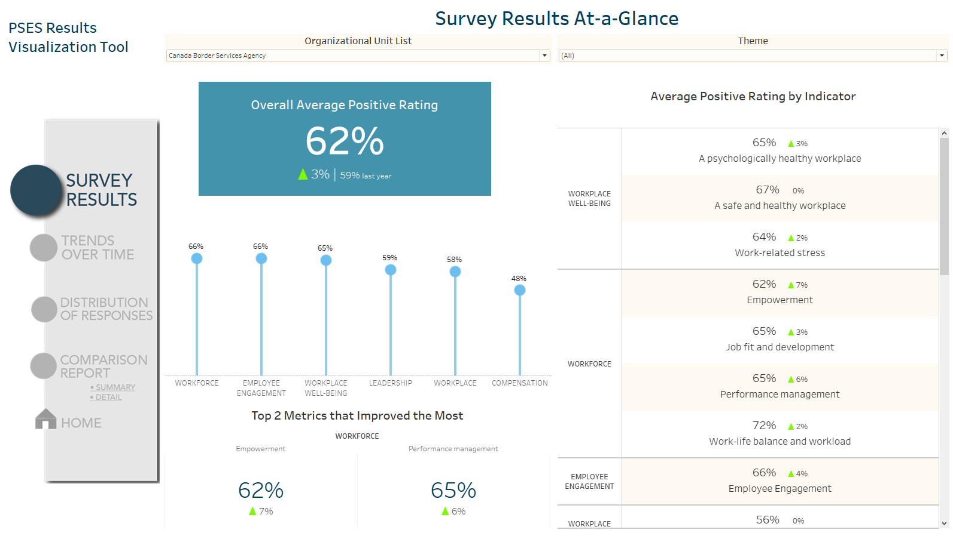

Slide 4
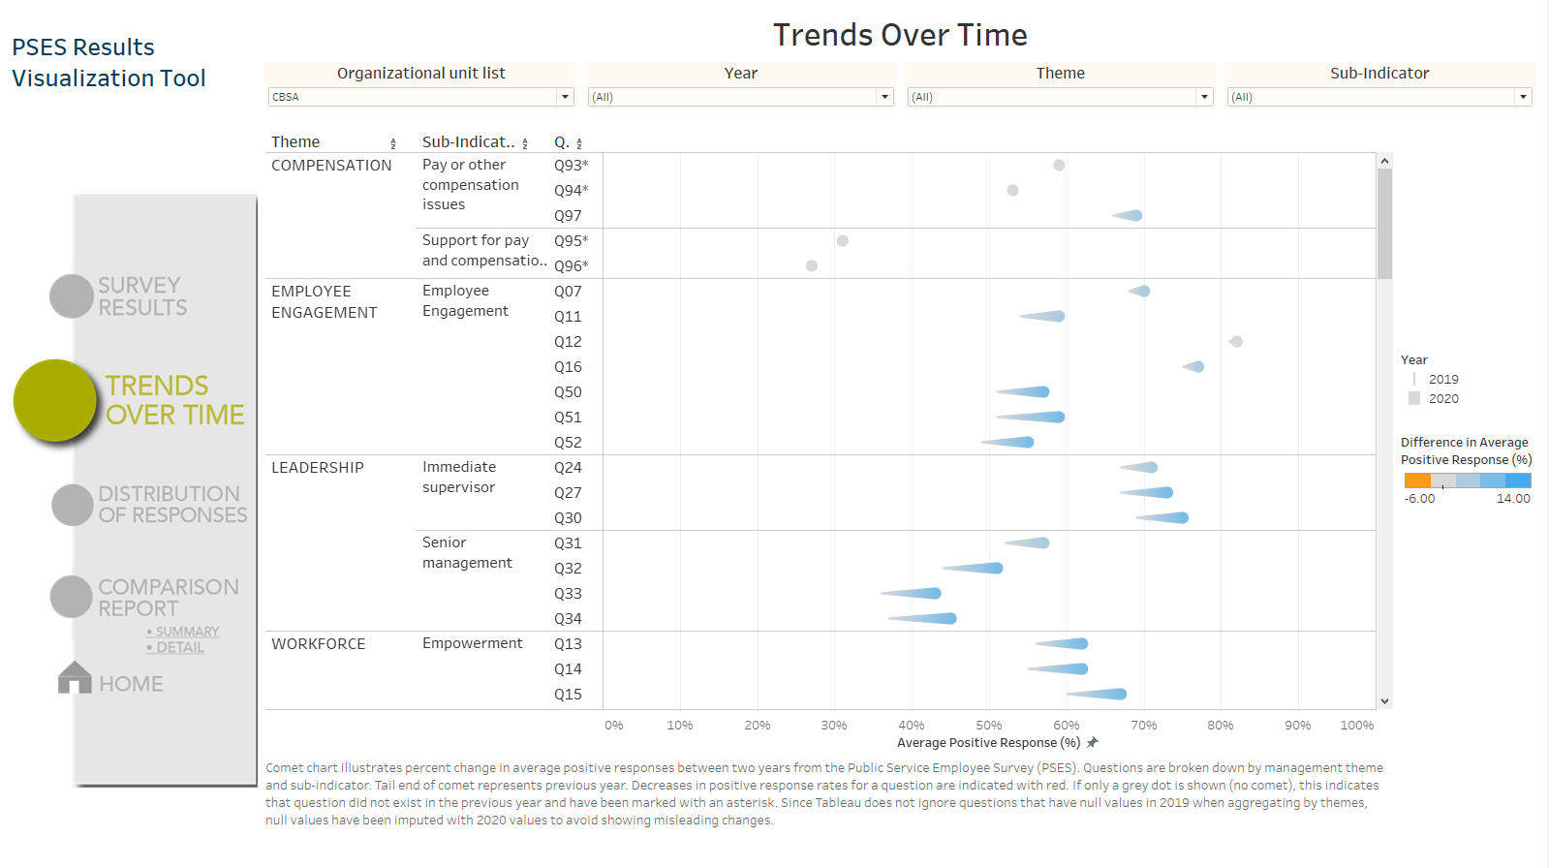

Slide 5
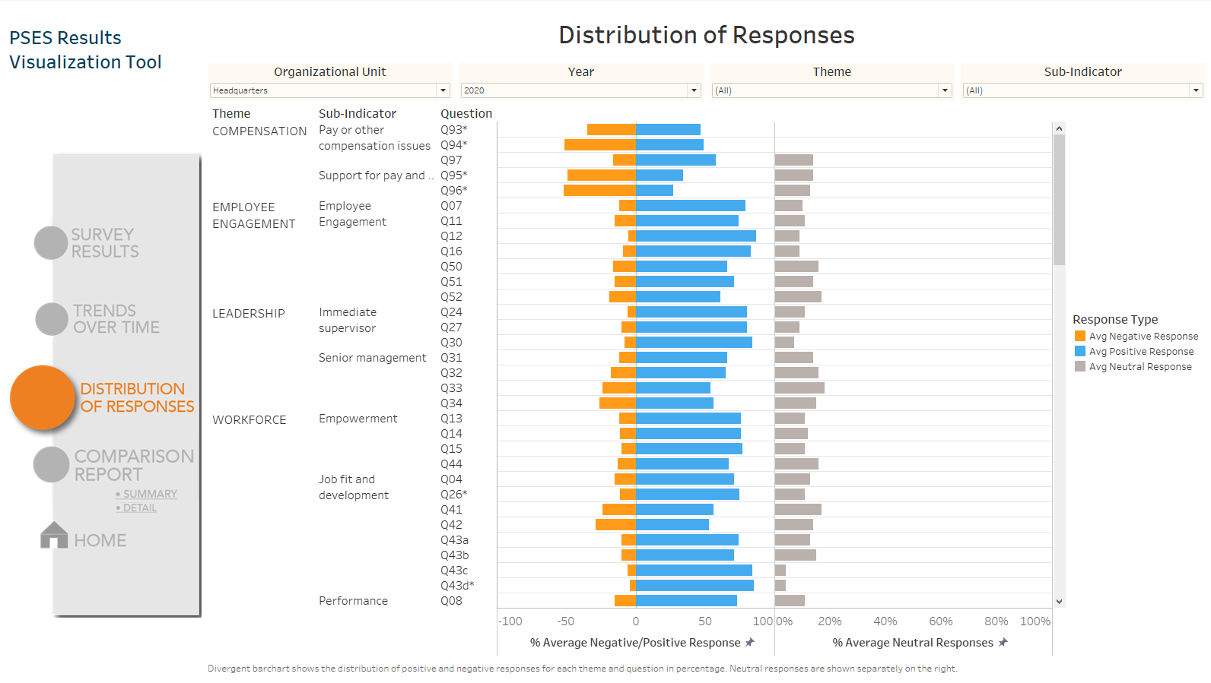

Slide 6
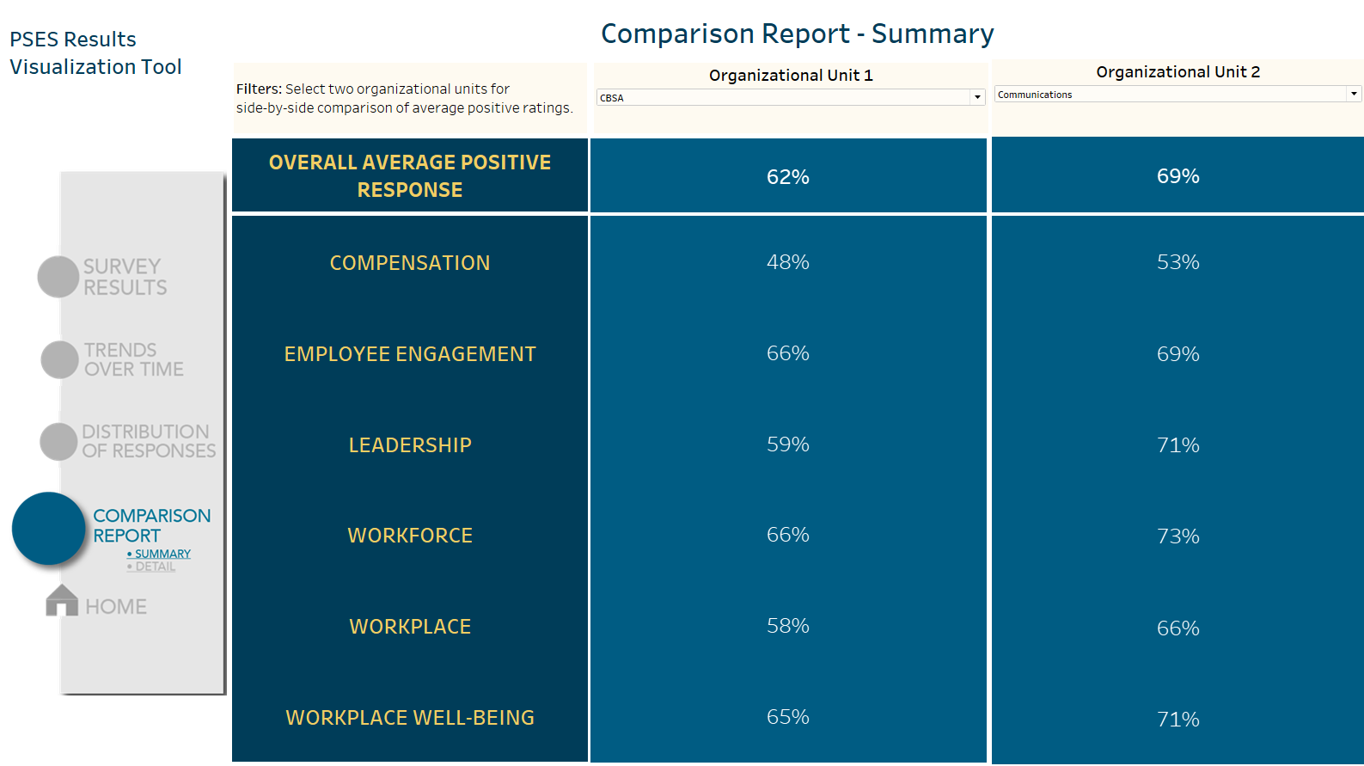

Slide 7
